Slide 1


FAIR-by-Design Methodology: How to Develop FAIR Learning Materials
Sonja Filiposka, UKIM
orcid.org/0000-0003-0034-2855
Notes:
30 mins

Slide 2
Why FAIR Learning Materials?
Enhanced discoverability
Contributes to a global learning community
Promotes sharing and adaptation
Supports open education
Saves time and resources
Facilitates collaboration
Makes learning more inclusive
Increased reusability
Learners can easily find what they need
Improved accessibility

Slide 3
FAIR for ALL
FAIR for Learners
Instructors
+
Find training content that can be easily accessed using common applications. Come back and revisit whenever needed.
Find existing training materials, access their editable versions, fully understand the context and reuse according to the licensing terms.

Slide 4
FAIR requires commitment
New skills
Know about metadata schemas, PIDs, repos, licensing, attribution, open file formats
Time, Time, More Time
Needed to provide full context and improve reusability.
Fast
Easy
Quick Fix
Devil is in the details
For full reuse materials should be accompanied with an instructor kit
By design
FAIRification may require substantial redo
Just share

Slide 5
FAIR-by-Design Methodology
Backward Instructional Design Empowered with FAIR principles
focusing on both learners and peer instructors
Prepare
Discover
Design
Produce
Publish
Verify
Deliver
1. Do you understand FAIR and its implications?
2. Define purpose, learning objectives, target audience
1. Find existing resources
2. Identify potential for reuse
attribution
tools & formats
1. Define syllabus and structure
- facilitation materials
- granularity
2. Decide on license
1. Develop content
- compatibility
2. Define metadata
3. Internal QA check
1. Release to public
- for learners & instructors
2. Ensure accessibility
- define attribution
3. Enable feedback gathering
1. Final QA check
2. Add to training catalogue
3. Use gathered feedback for continuous improvement

Slide 6
1 - Prepare
Package of:
min 1 learning outcome
lesson plan
lesson content
activity desc
assessment
facilitation guide
Define:
Purpose
Target audience
Prerequisites
Scope
Learn FAIR
Start Backward Instructional Design
Formulate Learning Objectives
Define FAIR Learning Objects
Ideate
Know how to curate and share FAIR data
Have legal IPR expertise
RDA min metadata schema
Focus on the learning outcomes that one wants to achieve. Work backward to the topics that need to be covered to achieve the learning objectives
Describe what new knowledge and skills will be obtained in a specific, measurable, attainable, relevant and time-bound (SMART) way
Use the Bloom’s Taxonomy

Slide 7

The RDA Minimal Metadata for Learning Resources
Image: Minimum set of metadata for learning resources
Taken from Hoebelheinrich, Nancy J, Biernacka, Katarzyna, Brazas, Michelle, Castro, Leyla Jael, Fiore, Nicola, Hellström, Margareta, Lazzeri, Emma, Leenarts, Ellen, Martinez Lavanchy, Paula Maria, Newbold, Elizabeth, Nurnberger, Amy, Plomp, Esther, Vaira, Lucia, van Gelder, Celia W G, & Whyte, Angus. (2022). Recommendations for a minimal metadata set to aid harmonised discovery of learning resources on Zenodo licensed under CC BY 4.0

Slide 8
2 - Discover
Get Inspired!
OER
EOSC
General
Multimedia
DOAB
MERLOT
OASIS
OER Commons
OERTX CORA
GALILEO
FORRT
Most EOSC projects have their own training catalogues and/or platforms
OpenPlato
Creative Commons Search
Zenodo
OSF
Discovery is a lengthy, windy process
Closed learning resources have value too
Provide for all learning modalities:
Read/write
Auditory
Visual
Kinesthetic

Slide 9
3 - Design
Create granular learning resources that can be easily reused
Mix and match while respecting licensing rules
A document that represents the trainers view and aims to enable a smooth and efficient organization
Concept
Develop
Feedback
Facilitation Guide
Structure
Learning unit plan
Content
Notebook
Slides
Activities
Assessment
Learners should be able to provide feedback on what worked well and what should be improved in the training and learning materials
Sketch a content concept map
Prepare a syllabus

Slide 10
Logical organisation
Root
resources
attachments
media files
questions file
(opt) 01 Section
(opt) 01 Module
01 Learning Unit
Activities
01 activity details
...
N activity details
Assessment
question bank
(opt) strategy
attachments
media files
learning content
slide deck
learning unit plan
...
N Learning Unit
syllabus
facilitator guide
README
LICENSE
CITATION
CODE_OF_CONDUCT
Feedback

Slide 11

4 - Produce
Tools & Formats
Accessibility
Re-iterate & Finalize
Internal QA
Editable vs Final
Open file formats
Web & Multimedia friendly
Granular versioning
Collaborative environment
Cover the widest range of learners variability
w+w/o assistive technology
W3C WCAG 2.1(2.2)
PDF/UA
Back and forth iterations
Metadata = human + machine – readable
License
Facilitation Guide
Self-assessment
Quantitative: required elements
Qualitative: per LU

Slide 12
Accessibility tips
present the information in multiple ways and formats
use simple language
option to provide additional resources
use headings
use table of content
provide alternative text for images
use equation editors for math expressions
use a high contrast colour palette
don't use colour as the only way to convey information
use descriptive links
use tables only when required
provide closed captions and transcripts

Slide 13
5 - Publish
Final preparations
To Repository
To LMS
Accompanying Files
(FAIR) repositories
For Learners
Readme
Citation
Code of conduct
…
fair-checker
Add to Catalogue
Add final content
Create quizzes
Setup feedback gathering
Add webinar room
Define credentials/badges

Slide 14
6 - Verify
FAIR-by-Design QA checklist
Required vs optional
Review w/o cognitive bias
From a new learner perspective
Setup gathering from both perspectives
QA checklist
Level of FAIRness
External QA
Feedback QA
LMS QA

Slide 15
Minimum FAIR Requirements
F
Metadata is provided in human- and machine-readable format
Resource is indexed in at least one searchable repository
A
Accessibility of all learning resource files checked
Access rules (authentication & authorisation) defined for the learning resource
I
The RDA minimal (or domain specific) metadata schema is used
Resource is available in open file formats
R
Clear attribution is provided for all reused resources with compatible licenses
Resource has a permissible license that allows derivations

Slide 16





Continuous Improvement
Reported issues
Discussion forum
Direct mail contact
Other means of communication
Select items from the list that will be part of a new version
2017
Internal
External
Analyze
Improve
Repeat
Feedback form
QA recommendations
Self-reflection after training
Create a list of potential improvements with impact level (high, moderate, low)
Start a new cycle of the FAIR-by-Design methodology

Slide 17
FAIR-by-Design Methodology Details
Up-to-Date Methodology
https://fair-by-design-methodology.github.io/FAIR-by-Design_Book/
ToT course on Skills4EOSC LMS
https://learning.skills4eosc.eu/course/view.php?id=19
Training Gitpages
https://fair-by-design-methodology.github.io/FAIR-by-Design_ToT/latest/
https://fair-by-design-methodology.github.io/microlearning/latest/

Slide 18



Slide 19

Help us improve
We are very interested in your thoughts and ideas
Let us co-create and make a new, improved, version of the FAIR-by-Design materials together
EC Survey is always open

Slide 20


Thank you! Questions? Credit: Some of the slides in this presentation were created by SlideEgg

Slide 21
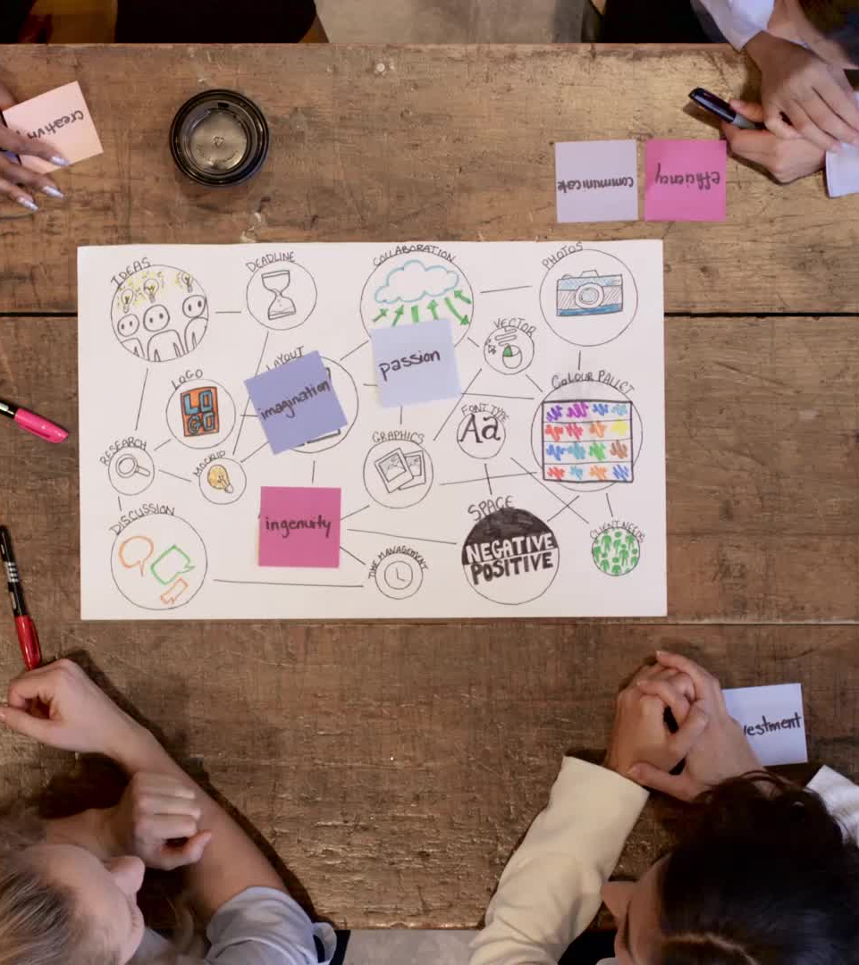
Now It's Your Turn!
Hands-on Activity
Apply what you've learned about FAIR-by-Design by working on a realistic scenario
Your Mission
Design key components of an Open Access training module for researchers.
Focus Areas
Learning objectives, target audience, reuse resources, outline learning activity, create a concept map, and plan for an instructor kit.
Next Steps
After the design phase, we’ll do a self-review quiz to help solidify your understanding.

Slide 22
Scenario
You are an instructional designer creating a training module about Open Access publishing, intended for researchers at your institution.
This module will be designed using the FAIR-by-Design methodology.

Slide 23

Use the template to get you started
https://fair-by-design-methodology.github.io/IDCC25workshop/latest/03%20FAIR-by-Design/fbd/#hands-on-activity

Slide 24

Learning Objective
Bloom's taxonomy by Fractus Learning. (2023, July 10). In Wikipedia licensed under the terms of CC BY-SA 4.0.

Slide 25

Discover & Reuse
This Photo by Unknown Author is licensed under CC BY-SA

Slide 26
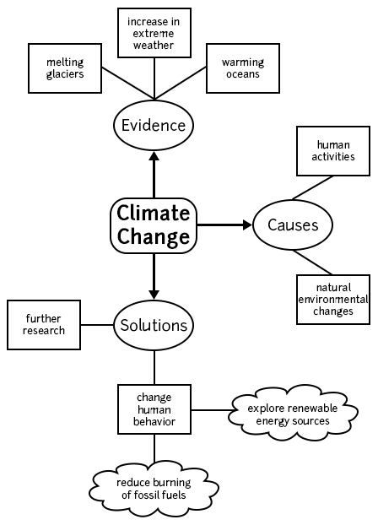
Design
Start with a Concept Map
This Photo by Unknown Author is licensed under CC BY-NC-ND

Slide 27
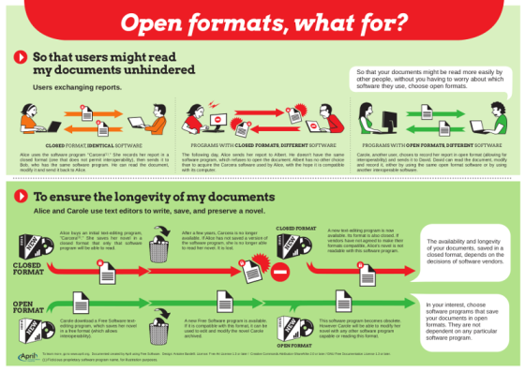
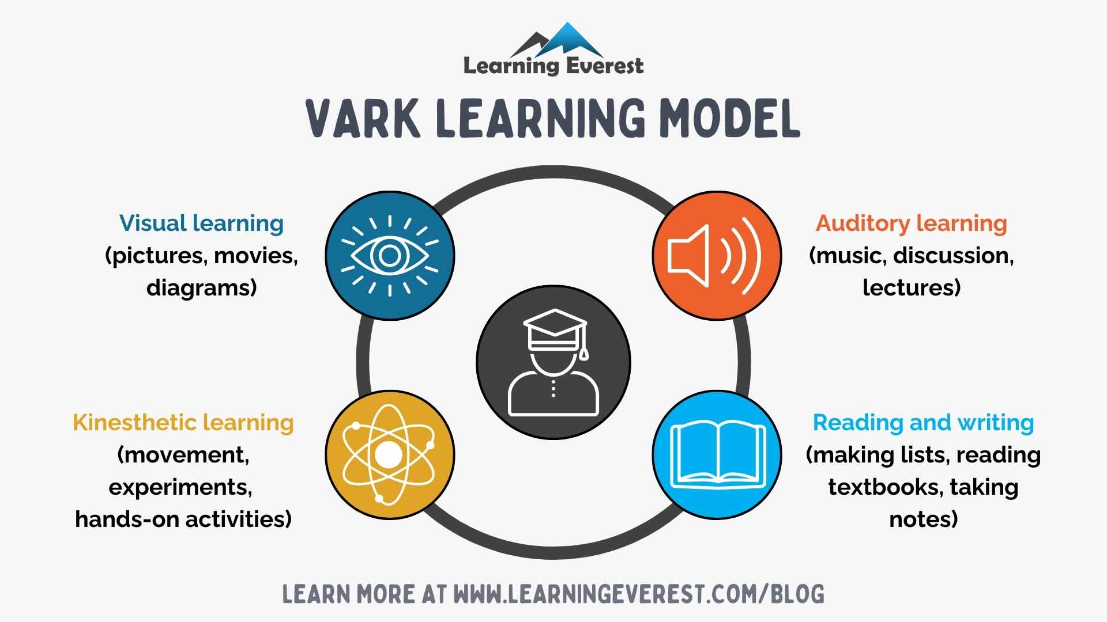
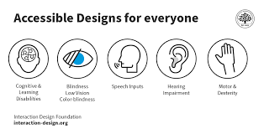
Produce learning content

Slide 28
Define an Instructor Kit
What another instructor would need to effectively deliver the module?

Slide 29

Great Job!
Now it is time to do some self-check… and try to win a prize ☺

